Slide 1
Imagine….by Kris Sward
I can’t imagine teaching online…….
http://www.flickr.com/photos/a-lish147/5021241570/sizes/m/in/photostream/

Slide 2
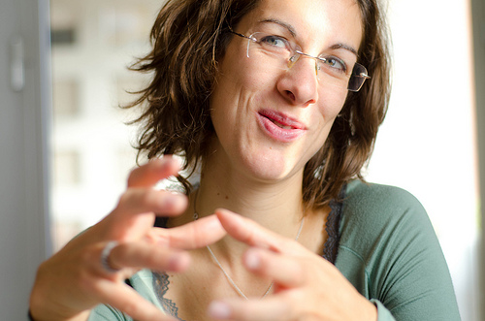
Wait – I can explain…
I mean in my classroom I can do a lot of things!
http://www.flickr.com/photos/nalbertini/6317803326/sizes/m/in/photostream/

Slide 3
I can be welcoming to learners of all ages and backgrounds...
http://www.flickr.com/photos/mjparnell/435465575/

Slide 4
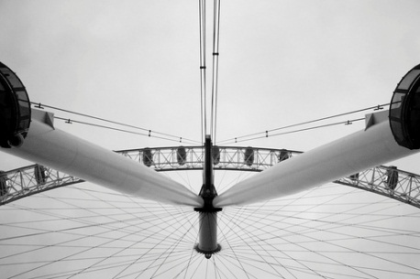
…I am supportive of my students, whatever their
struggles or situations…
http://www.flickr.com/photos/destinysagent/2784119139/sizes/m/in/photostream/

Slide 5
…I am there when they need a little HELP
from their friends…
http://www.flickr.com/photos/oxton/29721662/sizes/m/in/photostream/

Slide 6
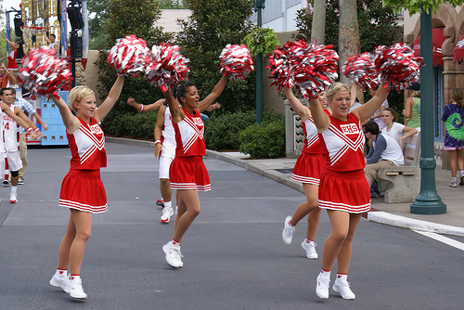
…I always try to motivate them and cheer them on…
http://www.flickr.com/photos/pcw_1333/1139029795/sizes/m/in/photostream/

Slide 7
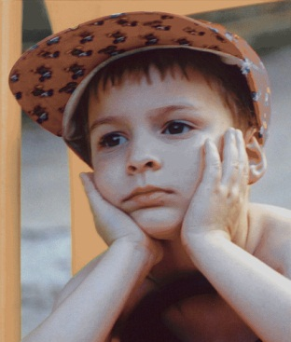
…I am patient with them and encourage them to problem solve for themselves…
http://www.flickr.com/photos/plasticrevolver/46486739/sizes/m/in/photostream/

Slide 8
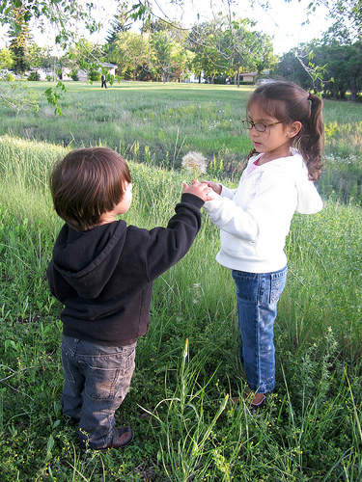
…I encourage them to be kind and respectful to others…
http://www.flickr.com/photos/courosa/3708151311/sizes/m/in/photostream/

Slide 9
…I try to create exciting lessons for them…
http://www.flickr.com/photos/bayasaa/2693171833/sizes/m/in/photostream/

Slide 10
…lessons that are also engaging for them and make them want to know more…
http://www.flickr.com/photos/telachhe/4641589345/sizes/m/in/photostream/

Slide 11
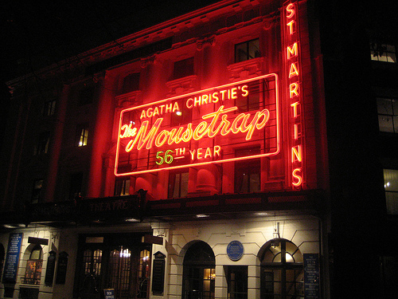
…lessons that are perhaps a bit…mysterious…
http://www.flickr.com/photos/aroberts/3032490151/sizes/m/in/photostream/

Slide 12
…and let’s not forget funny and entertaining…
http://www.flickr.com/photos/everydayelsie/3612303318/sizes/m/in/photostream/

Slide 13
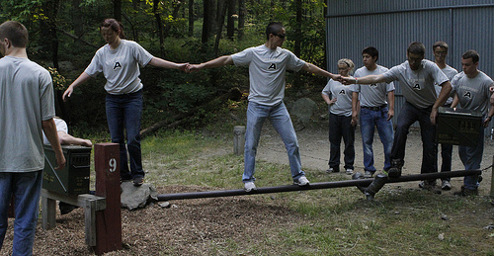
…I encourage my students to collaborate to solve problems…
http://www.flickr.com/photos/west_point/5818583334/sizes/m/in/photostream/

Slide 14
…I try to inspire them to want to do new things and learn more…
http://www.flickr.com/photos/davidyuweb/6974933121/sizes/m/in/photostream/

Slide 15
…and challenge them to go further than they ever thought they could…
http://www.flickr.com/photos/west_point/6257369389/sizes/m/in/photostream/

Slide 16
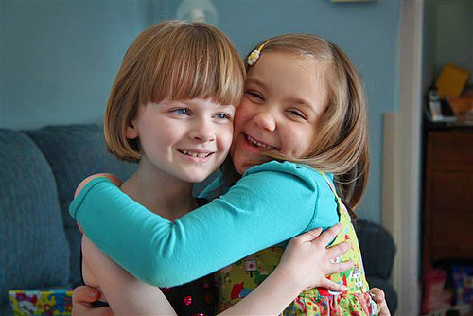
…I reassure them when they doubt themselves or don’t think they can do it…
http://www.flickr.com/photos/clover_1/5380803053/sizes/m/in/photostream/

Slide 17
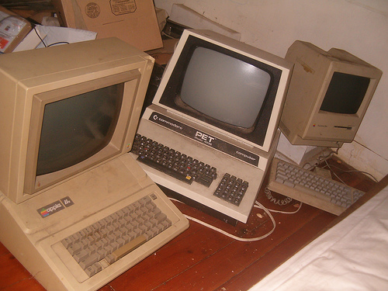
OLTD
…I am innovative…
http://www.flickr.com/photos/eurleif/255241547/sizes/m/in/photostream/

Slide 18
…creative…
http://www.flickr.com/photos/slurm/3546246044/sizes/m/in/photostream/

Slide 19
…and open to change…
http://www.flickr.com/photos/freefoto/3239197673/sizes/m/in/photostream/

Slide 20
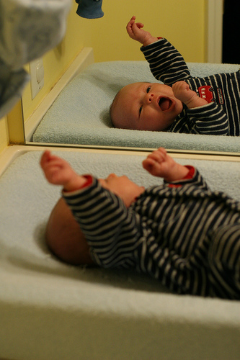
I am already doing all of these things… ...and I IMAGINE I could also do them online…
Hmmm...
maybe it’s not so different…
Okay –
I can do this!
☺
(I think!)
http://www.flickr.com/photos/robenjoyce/3259443830/sizes/m/in/photostream/

